Slide 1

Customer Segment Analysis
Personal Project
Batch : 4
Team: 1
Presented by :- Rahul Singh

Slide 2
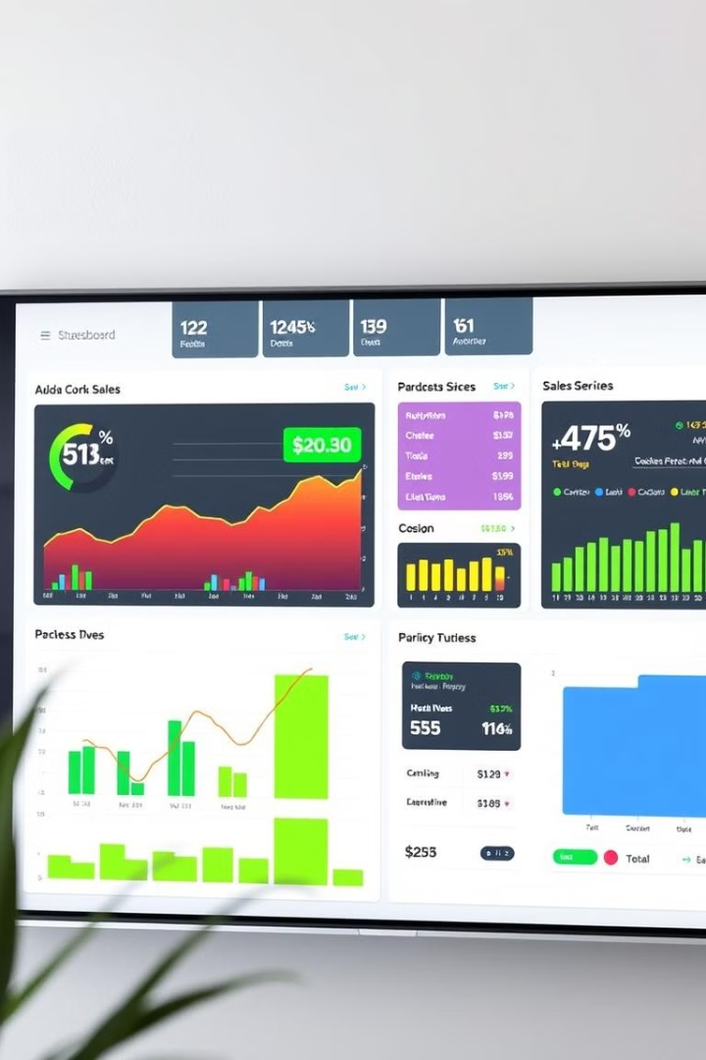
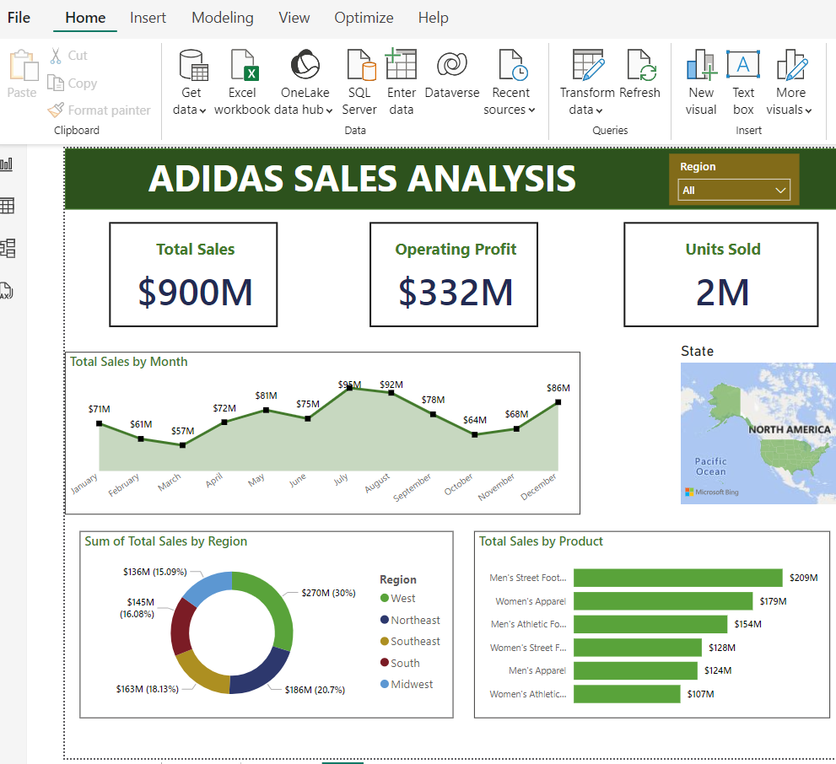
Adidas US Sales Dashboard: A Comprehensive Analysis of Sales Performance
This presentation will provide a comprehensive analysis of Adidas sales performance in the United States, using a powerful data visualization tool called Power BI. We'll dive into key performance indicators, regional breakdowns, and insights gleaned from the data, culminating in actionable recommendations for driving future growth.

Slide 3
Introducing Power BI
Data Visualization Powerhouse
Interactive and Dynamic
Power BI is a robust and user-friendly data analysis tool that offers a wide range of visualization capabilities, transforming raw data into compelling and actionable insights. It's a valuable tool for understanding trends, identifying growth opportunities, and driving strategic decision-making.
Power BI dashboards are interactive, allowing users to drill down into specific data points, explore relationships, and gain deeper insights. This dynamic approach empowers decision-makers to make informed choices.

Slide 4
Dataset Overview
Regional Performance
Product Categories
Sales Trends
Sales Channels
The dataset includes detailed information on Adidas' retail performance across various regions, states, and cities, providing insights into the geographical distribution of sales.
The dataset features a breakdown of revenue, profit, and margins across product categories, allowing us to understand the performance of specific product lines.
Time-series analysis is included, allowing us to track sales trends over time, identifying patterns, seasonality, and potential growth opportunities.
The dataset provides information about the different sales channels, including online, retail stores, and wholesale partners, enabling us to analyze channel contribution.

Slide 5

Data Preprocessing: The Foundation of Success
Data Cleaning
Data Transformation
Ensuring data quality is paramount. This step involves identifying and removing inconsistencies, duplicates, or missing values that could skew the results. We ensure the data is accurate and reliable for meaningful analysis.
Transforming data for analysis involves converting it into a format that aligns with the analytical objectives. This might involve restructuring, standardizing, or aggregating data to derive meaningful insights.

Slide 6



Data Modeling: Building a Solid Framework
Relationships
Defining relationships between tables is crucial for creating a comprehensive data model. This allows us to connect data across different sources, enabling a holistic view of Adidas sales data.
1
Dimensions and Measures
2
We carefully define dimensions (attributes like region, product category) and measures (quantifiable metrics like revenue, profit) to ensure the data model accurately reflects business requirements.
Hierarchical Structure
3
Building a hierarchical structure within the data model enables us to analyze data at different granularities, moving from region-level insights to specific store or product performance.

Slide 7

Key Performance Indicators
$900M
2 million
Total Sales
Units Sold
The total sales figure for Adidas in the U.S. provides a broad understanding of the overall market performance.
Units sold represent the volume of products shipped and sold, reflecting consumer demand for Adidas products.
$332 million
42%
Operating Profit
Average Operating Margin
Operating profit is a key indicator of profitability, calculated by subtracting operating expenses from revenue.
Average operating margin measures profitability relative to revenue, indicating the percentage of revenue that remains after covering operating costs.

Slide 8
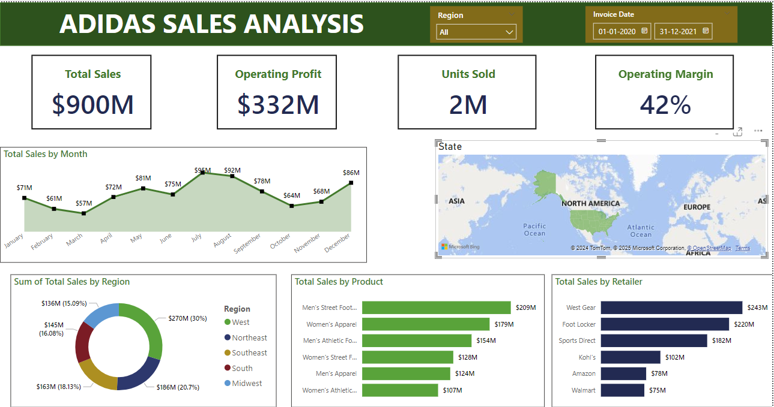
Dashboard Overview

Slide 9
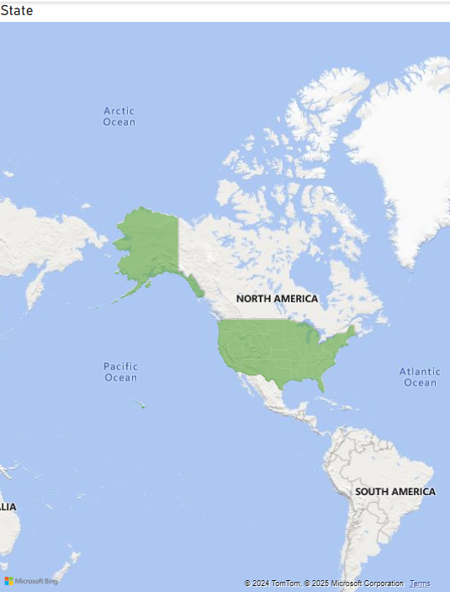
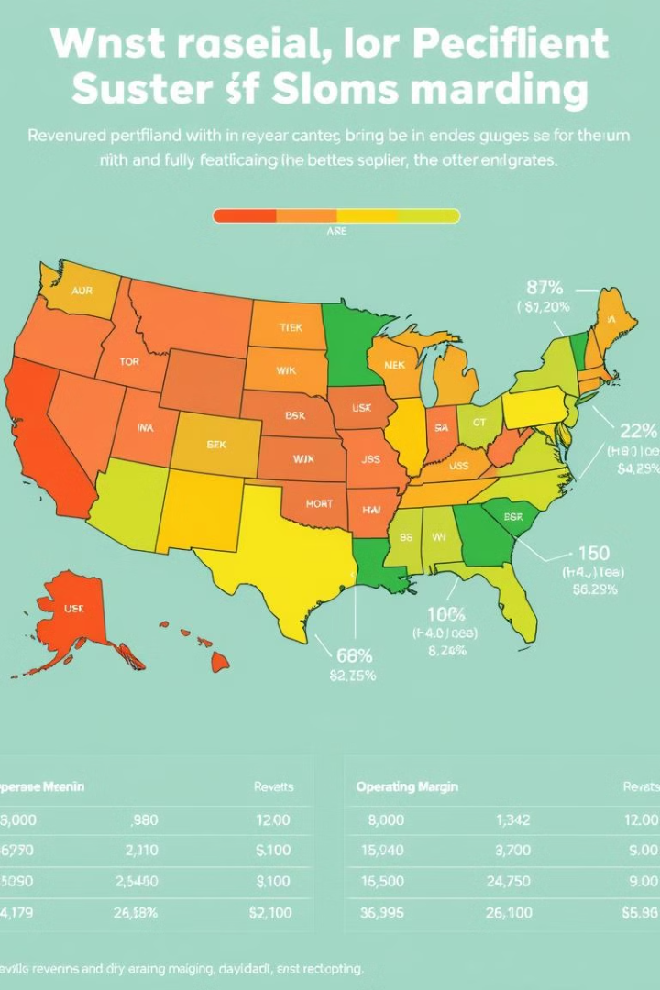



Regional Analysis: Unveiling Geographic Trends
Northeast
South
The Northeast region boasts the highest revenue, demonstrating strong consumer demand in this area.
The Southern region showcases an impressive operating margin, indicating efficient operations and profitability in this market.
West
The Western region presents significant growth potential, highlighting opportunities for expansion and market share gains.

Slide 10
State-Level Sales: Deeper Insights
California
1
California stands out as the top performing state, generating the highest total sales revenue.
New York
2
New York exhibits strong unit sales, indicating significant consumer demand for Adidas products in this densely populated state.
Texas
3
Texas emerges as a promising growth market, highlighting the potential for future expansion and increased market share.

Slide 11
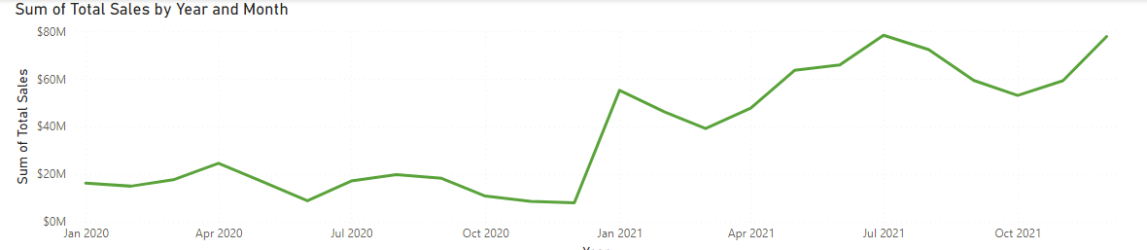

Actionable Insights and Recommendations
The insights gained from the data analysis provide valuable guidance for Adidas' future strategies. By focusing on high-performing regions, expanding into emerging markets, and optimizing product categories, Adidas can drive continued growth and success in the US. Further exploration of the dataset will yield even deeper insights, enabling us to make data-driven decisions that support Adidas' overall business objectives.

Slide 12
Thank you

